Slide 1
Pandemic Pulse:
Toronto Crime Patterns Exposed
Group 06
Julian Panditharatne
Rasadari Ranasinghe
Neal Labern
Mahanaz Koz
Lavanya Bhanot

Slide 2
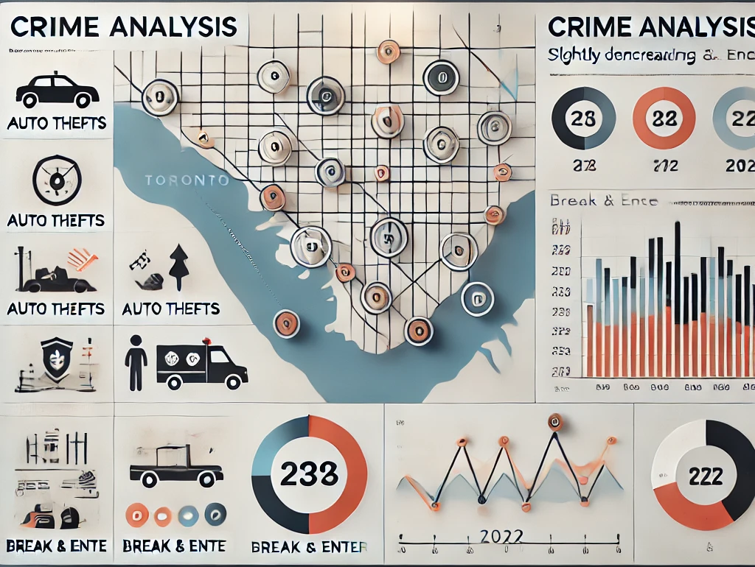

OUTLINE
Introduction
Workflow of the project
Visualizations
Summary & Conclusion

Slide 3


INTRODUCTION
Objective :
Analyze COVID-19 and crime data in Toronto to identify patterns and trends.
The COVID-19 pandemic has profoundly impacted cities worldwide.
This project visualizes changes in crime patterns before and during the pandemic, offering insights into how these events may have influenced criminal behavior.

Slide 4



WORKFLOW OF THE PROJECT
1. Data Collection
2. Loading the data to serverless Mongo Database
3. Working on the data and creating the website
Used different sites to collect the crime and covid data in Toronto
https://open.toronto.ca/dataset/major-crime-indicators/
https://open.toronto.ca/dataset/neighbourhoods/
Toronto Police Service Public Safety Data Portal
Collected data was loaded and
Created APIs to get data from Mongo Database
Used JavaScript to create visualizations
Libraries used,
Leaflet
Node
Created index.html and js files to create a website
Website was deployed to the GitHub page

Slide 5

Loading the data into the Mongo DB

Slide 6

After Hours of work we were finally able to clean the data to create a database

Slide 7

Reading the data for visualization purposes

Slide 8

API was our final fix

Slide 9
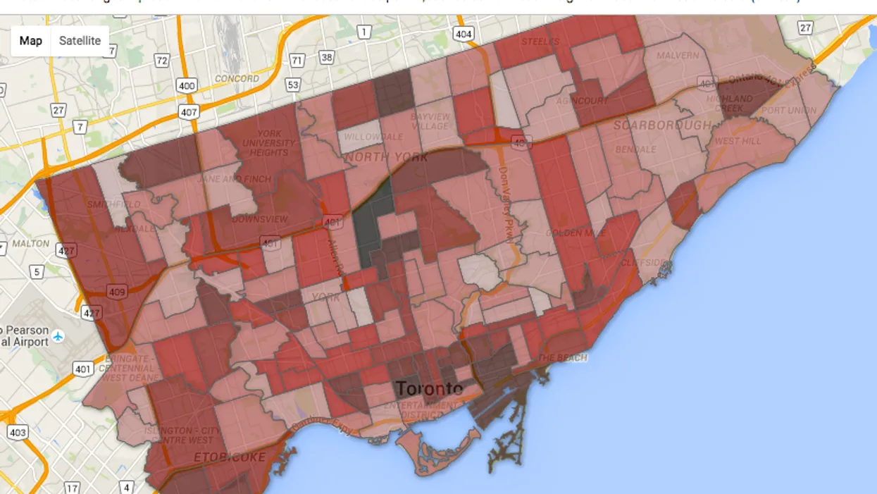
Let’s visualize the the relation between COVID-19 and Crime rate in Toronto

Slide 10
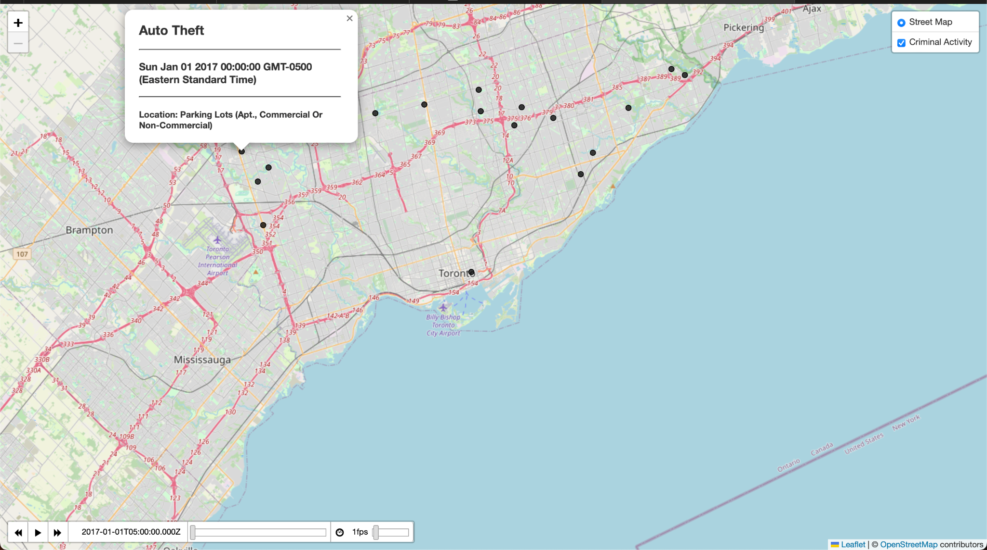
VISUALIZATIONS
This dynamic map visualizes criminal activities that occurred from 2017 to 2022, capturing data both before and during the COVID-19 pandemic.
Used a temporal slider allowing users to navigate the spread of criminal activities and explore trends over time .

Slide 11
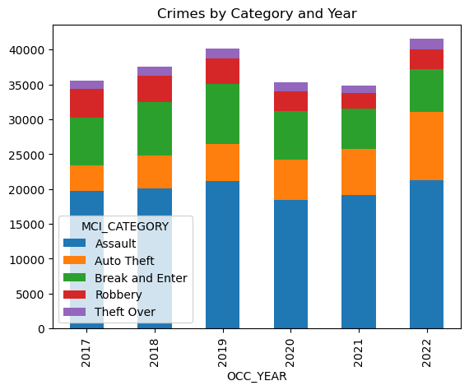
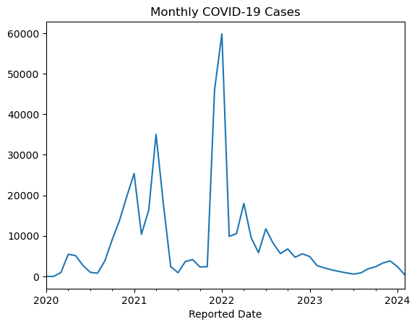
Effect of COVID on the Crime Rate Majorly during the lockdown

Slide 12


Economic Strain on people and Canada Emergency Response Benefits

Slide 13

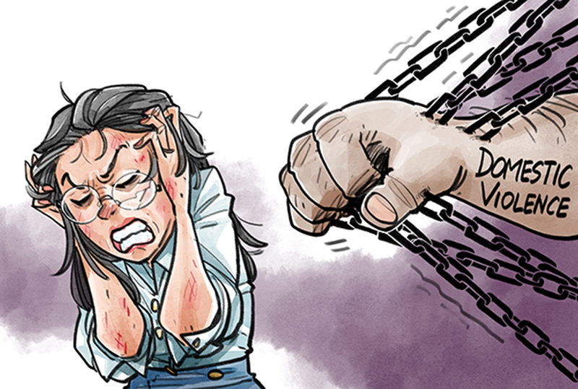
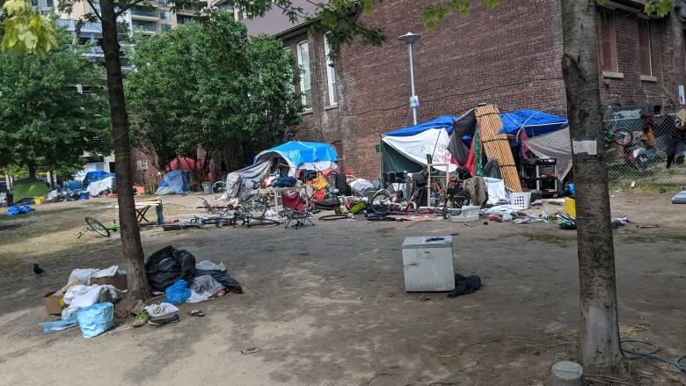

Unreported crime and future research aspects

Slide 14
SUMMARY & CONCLUSION
Overall Increase: Crime rates showed an overall increase in 2022 which had the highest reported COVID-19 cases.
Auto Theft: Significant rise in auto theft incidents during 2022.
Robbery and Break & Enter: Both robbery and break & enter incidents experienced a slight decrease in 2022.
The data suggests that the pandemic may have influenced criminal behavior, with notable changes in certain crime categories during 2022.

Slide 15

Thank you

